Slide 1


Raspberry Pi 3 - Lecture 2-
H. Melih Erdogan
Lab Assistant
Intelligent Robotics I - ECE 478/578
Electrical and Computer Engineering Department Maseeh
College of Engineering and Computer Science

Slide 2
Lecture Overview
Raspberry Pi Setup
SSH
Linux
Python
Digital Signals
Demo 1
Demo 2
Demo 3

Slide 3
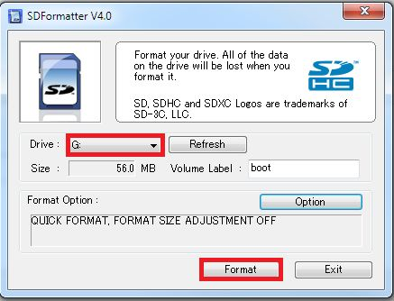
SD Formatter

Slide 4
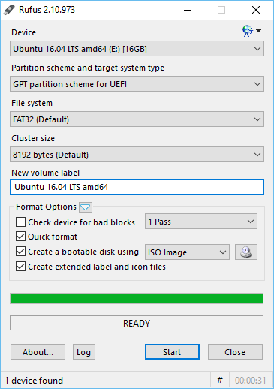
Rufus
Choose the device
Label the volume (use any name)
Choose the image file that you downloaded
Click on start

Slide 5
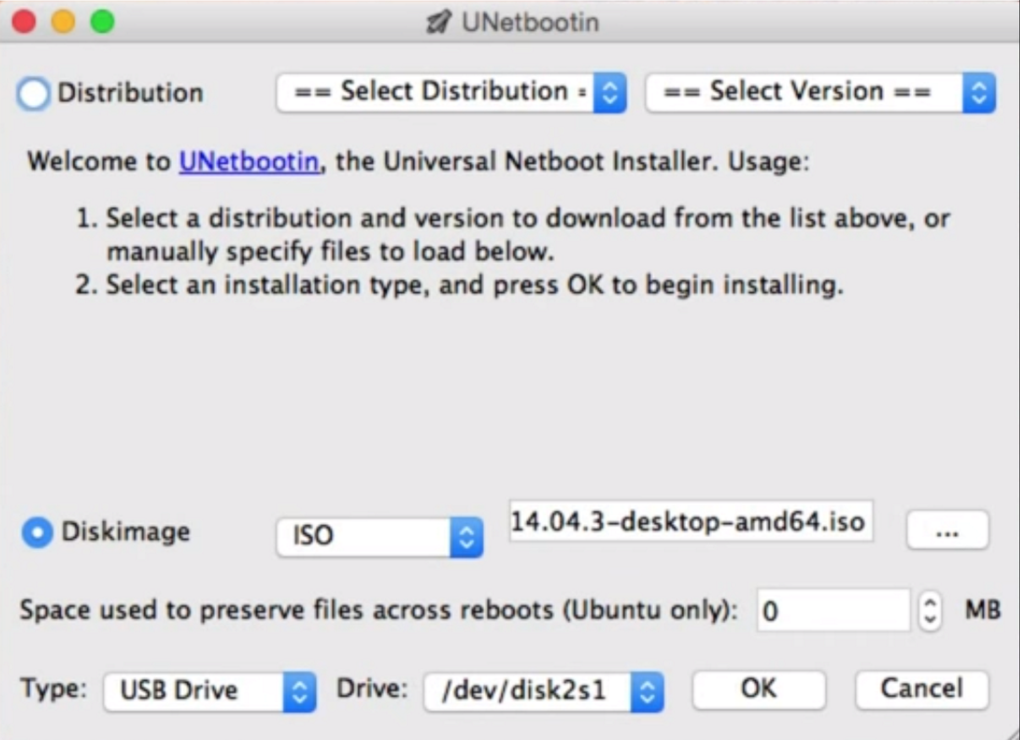
MAC OSX - Ubootin
Select disk image
Choose image file format
Choose the image file
Make sure you pick the right drive

Slide 6
Raspbian - Login
Default user name: pi
Default password : raspberry
Type “startx” to start the GUI

Slide 7
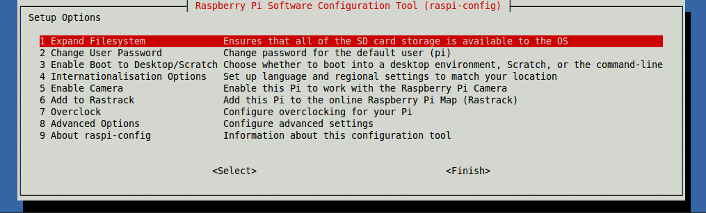
Raspberry Pi Software Configuration Tool raspi-config

Slide 8
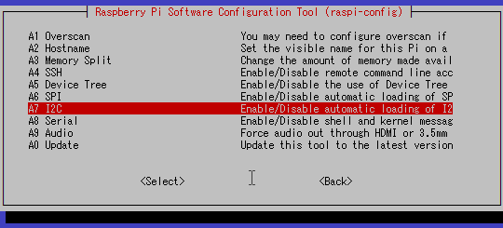
Advanced Options

Slide 9
Wi-Fi Connection
WiFi Network Name: Jimmy
Password: robotics

Slide 10
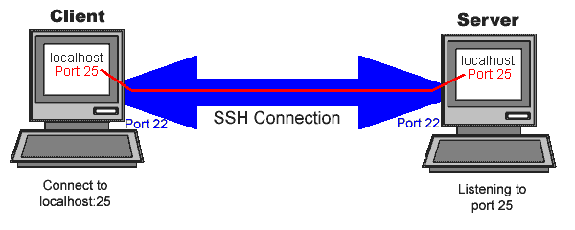
SSH
SSH, also known as Secure Socket Shell, is a network protocol that provides administrators with a secure way to access a remote computer.
In our case, we will use SSH connection to remote control our Raspberry Pi computers.

Slide 11
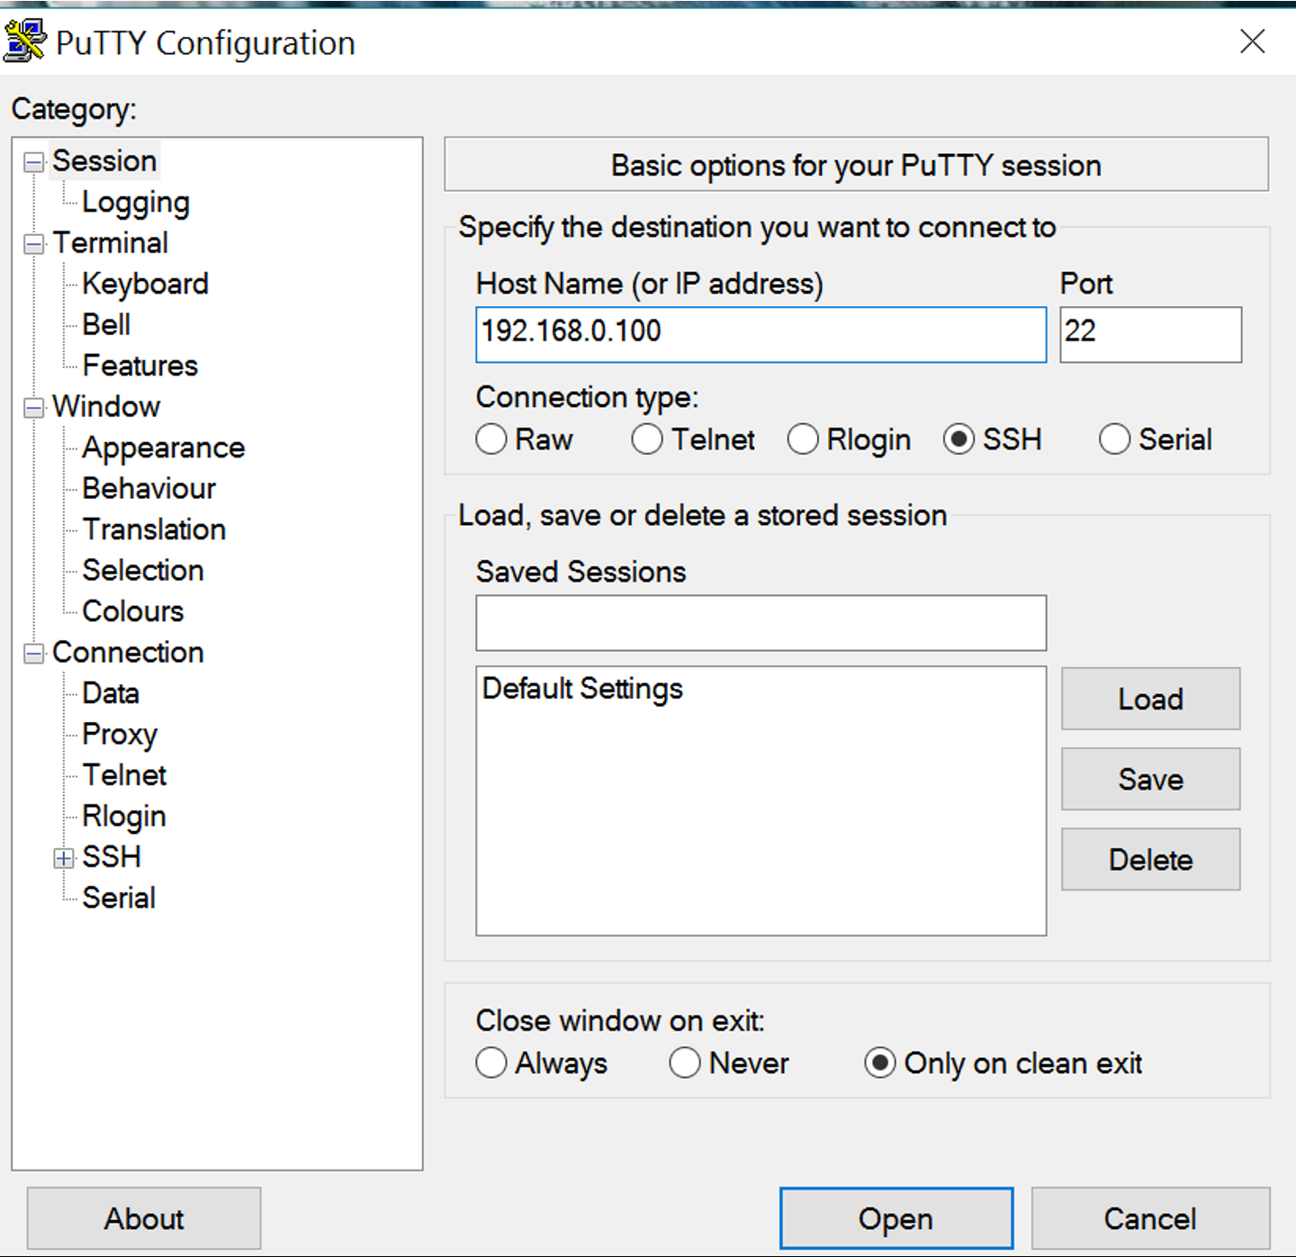
SSH - Windows
Type Raspberry Pi’s IP Address
Click on Open

Slide 12
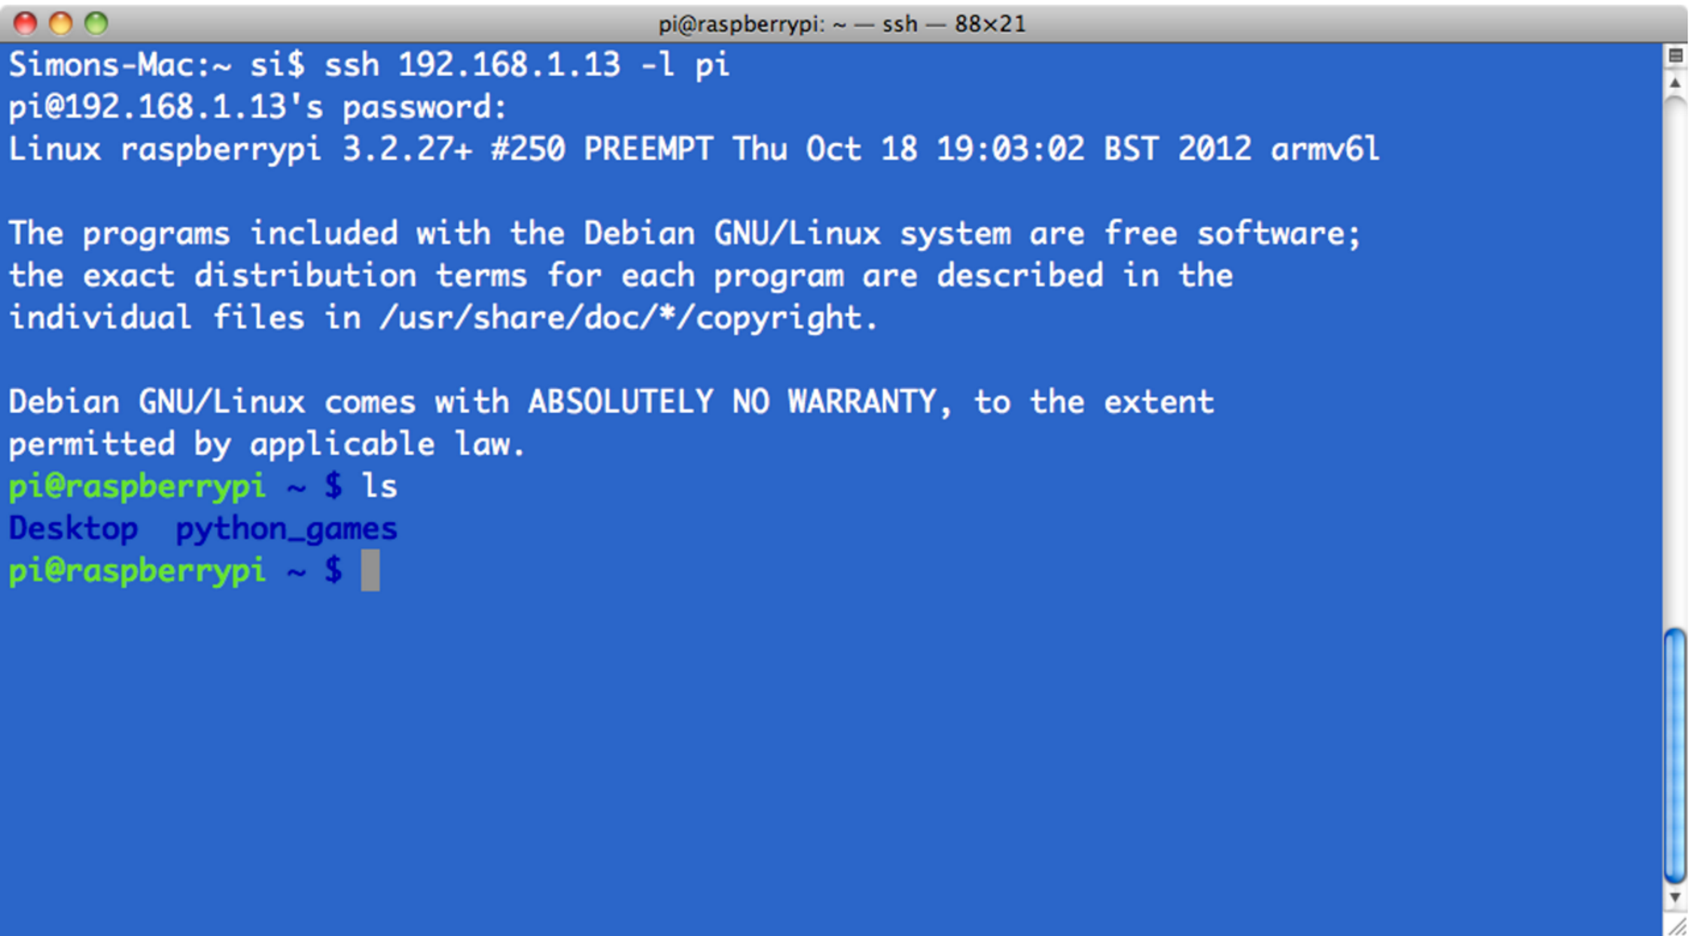
SSH – MAC OSX and Linux
ssh <ip address> -l pi
ssh 192.168.1.13 -l pi

Slide 13
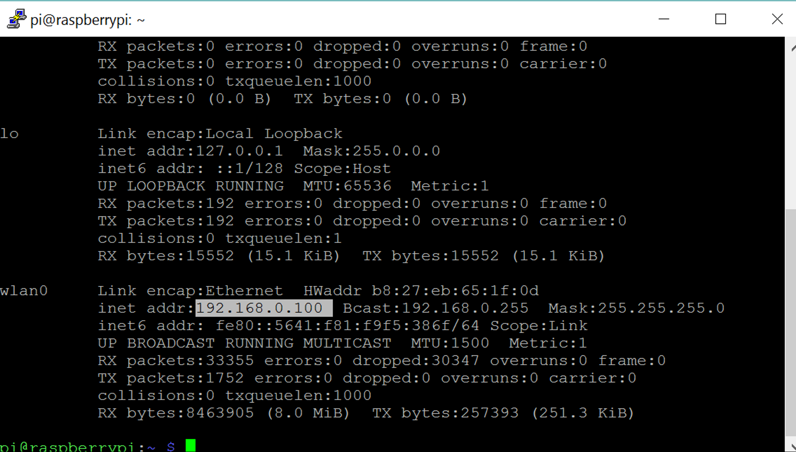
How to learn your IP address?

Slide 14
Linux – Useful Linux Commands
ls : Lists the content of the current directory
cd : Changes the current directory to the one specified
pwd: Displays the name of the current working directory
mkdir: Makes a new directory
rmdir: Remove empty directories
nano:
rm: Removes the specified file
cp: Makes a copy of a file and places it at the specified location
mv: Moves a file and places it at the specified location

Slide 15
Linux – Useful Linux Commands
cmod : Normally used to change the permissions for a file
ssh: Secure shell. Connect to another computer using an encrypted network connection
sudo: Run a command as a superuser, or another user.
unzip : Extracts the files from a compressed zip file.
Ifconfig : Displays the network configuration details for the interfaces on the current system when run without any arguments
sudo shutdown –h

Slide 16
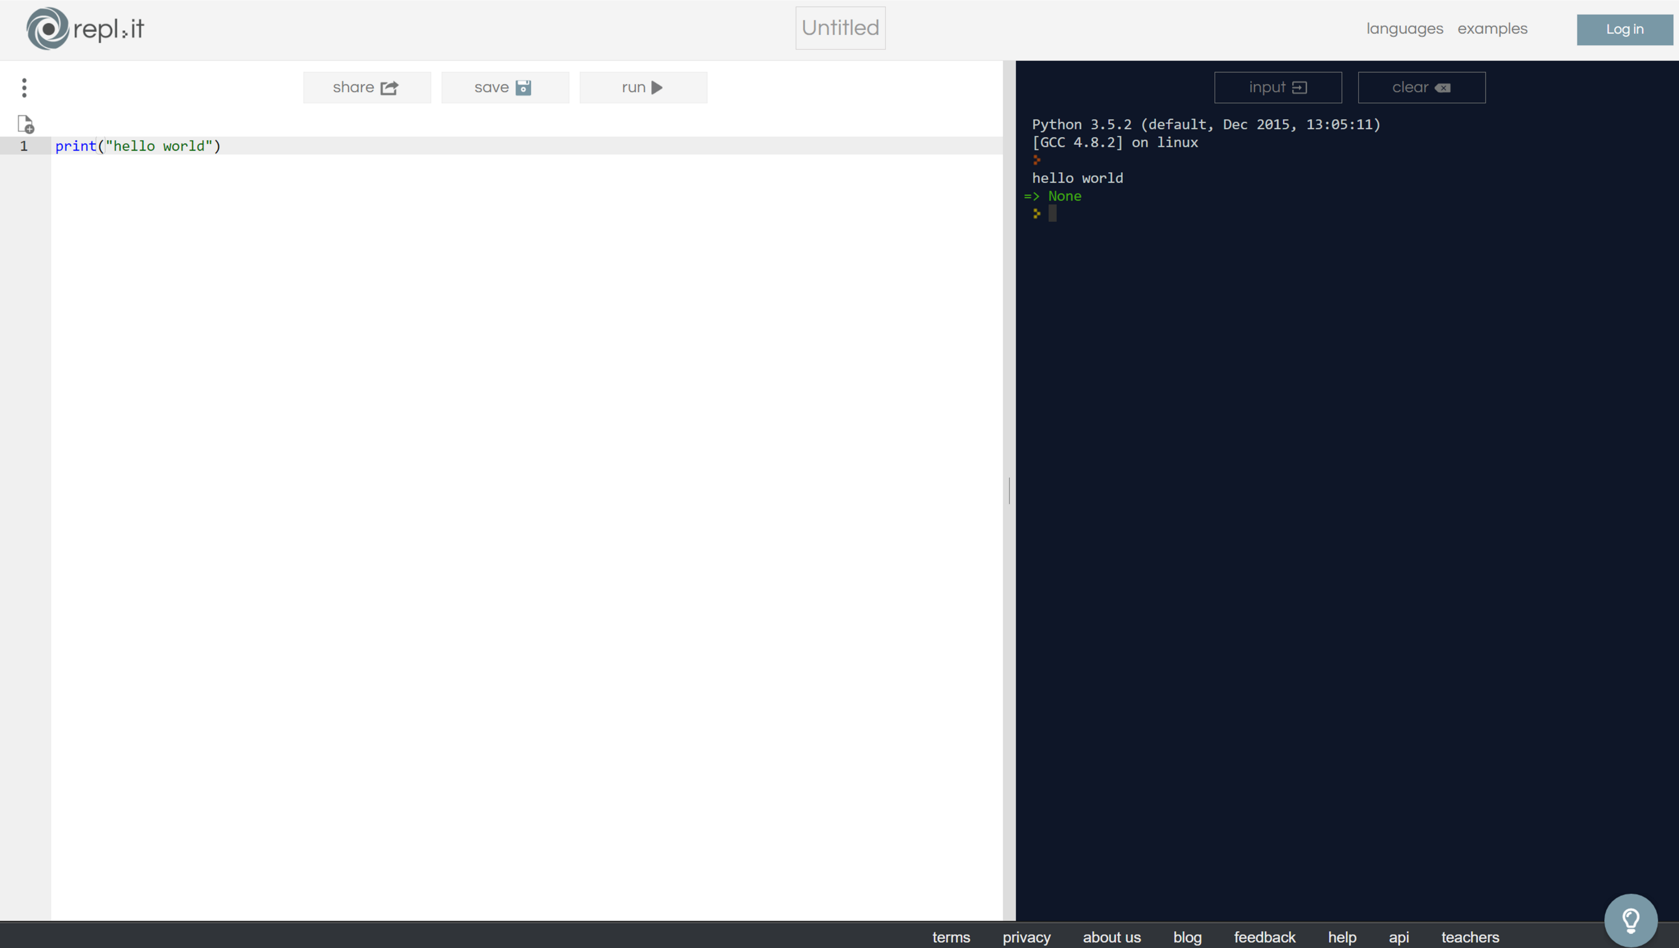
Python Compiler
https://repl.it/languages/python3

Slide 17
Python Basics
Python is an easy to learn, powerful programming language. It has efficient high-level data structures and a simple but effective approach to object-oriented programming. Python’s elegant syntax and dynamic typing, together with its interpreted nature, make it an ideal language for scripting and rapid application development in many areas on most platforms.
https://www.python.org/
https://docs.python.org/3/tutorial/index.html
We will use Python 3.

Slide 18
Why Python is great?
Python is Interpreted: Python is processed at runtime by the interpreter. You do not need to compile your program before executing it. This is similar to PERL and PHP.
Python is Interactive: You can actually sit at a Python prompt and interact with the interpreter directly to write your programs.
Python is Object-Oriented: Python supports Object-Oriented style or technique of programming that encapsulates code within objects.
Python is a Beginner's Language: Python is a great language for the beginner-level programmers and supports the development of a wide range of applications from simple text processing to world wide web browsers to games.

Slide 19
Reserved Words
The following list shows the Python keywords. These are reserved words and you cannot use them as constant or variable or any other identifier names. All the Python keywords contain lowercase letters only.
and | exec | not
assert | finally | or
break | for | pass
class | from | print
continue | global | raise
def | if | return
del | import | try
elif | in | while
else | is | with
except | lambda | yield

Slide 20
Variable
# This is how you comment
name = “Marek Perkowski” # This is a string variable
print(name)
print “hello world”
number = 1903 # This is an integer variable
my_gpa = 3.99 # This is A floating point variable

Slide 21
Operators
+ Addition | Adds values on either side of the operator. | a + b = 30
- Subtraction | Subtracts right hand operand from left hand operand. | a – b = -10
* Multiplication | Multiplies values on either side of the operator | a * b = 200
/ Division | Divides left hand operand by right hand operand | b / a = 2
% Modulus | Divides left hand operand by right hand operand and returns remainder | b % a = 0
** Exponent | Performs exponential (power) calculation on operators | a**b =10 to the power 20
// | Floor Division - The division of operands where the result is the quotient in which the digits after the decimal point are removed. But if one of the operands is negative, the result is floored, i.e., rounded away from zero (towards negative infinity): | 9//2 = 4 and 9.0//2.0 = 4.0, -11//3 = -4, -11.0//3 = -4.0

Slide 22
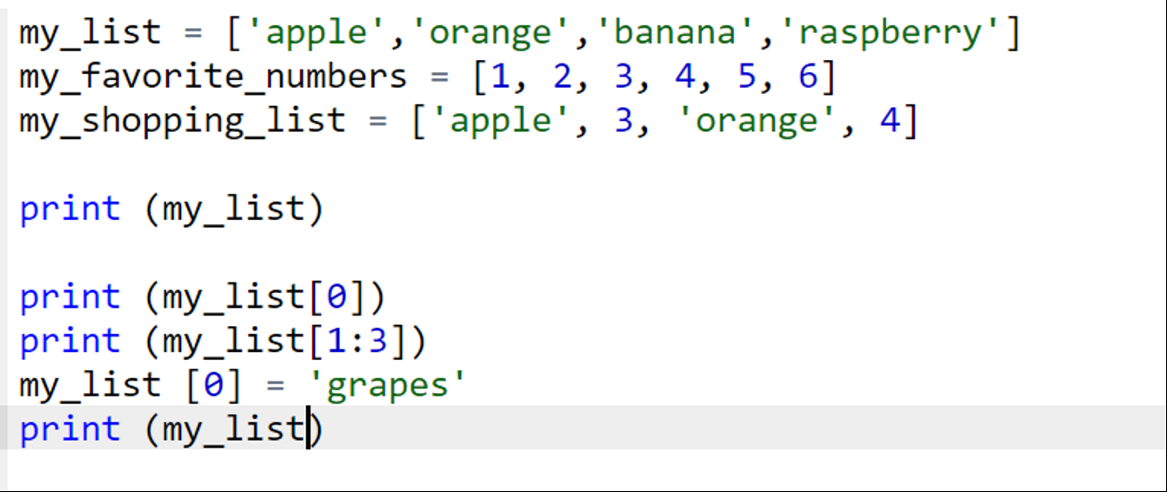
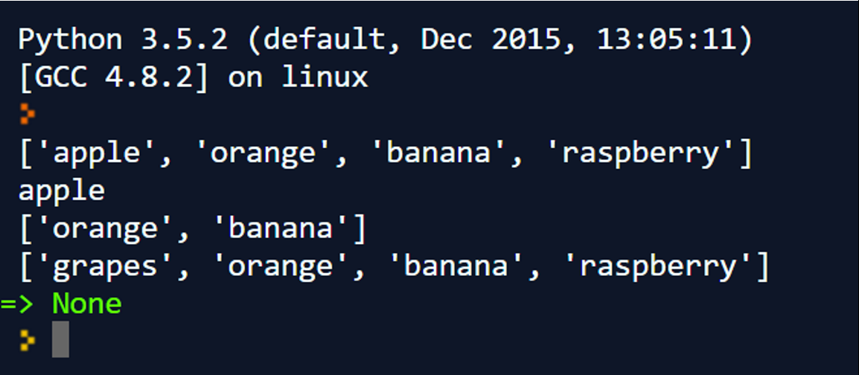
Lists
A list contains items separated by commas and enclosed within square brackets.

Slide 23
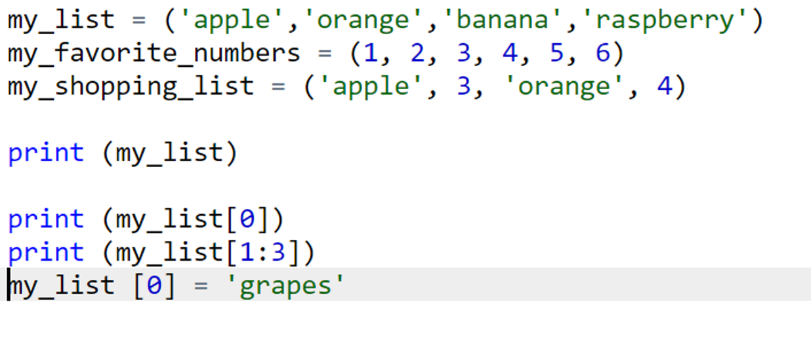
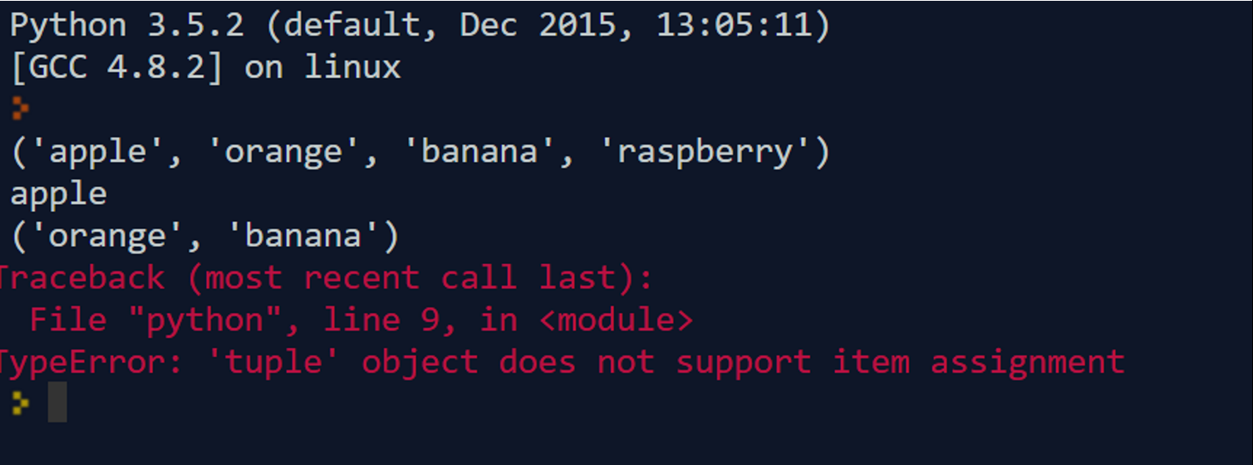
Tuples
A tuple is another sequence data type that is similar to the list. A tuple consists of a number of values separated by commas. Unlike lists, however, tuples are enclosed within parentheses.
It is only-read

Slide 24
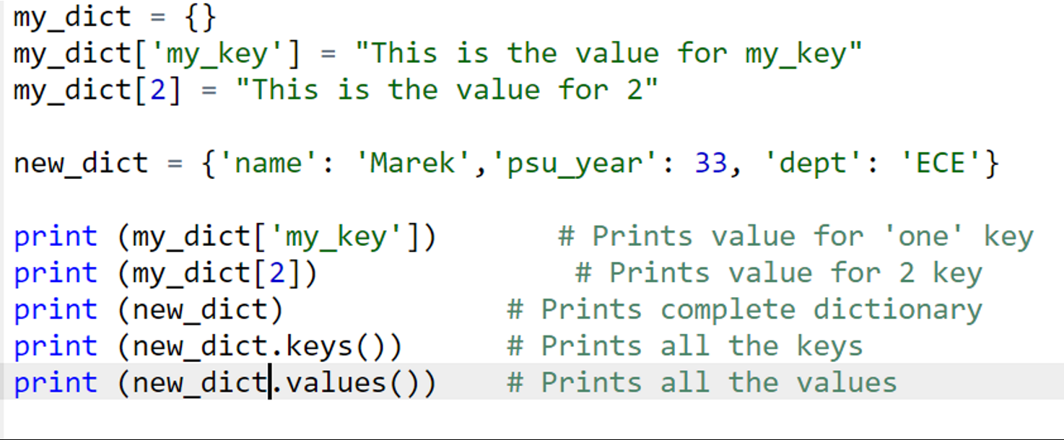
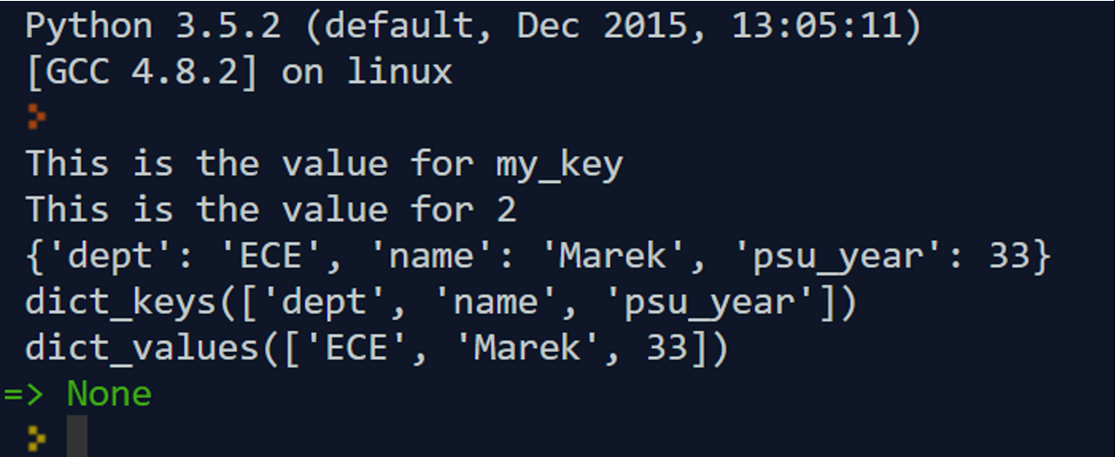
Dictionary
Python's dictionaries are kind of hash table type. They work like associative arrays or hashes found in Perl and consist of key-value pairs. A dictionary key can be almost any Python type, but are usually numbers or strings. Values, on the other hand, can be any arbitrary Python object.

Slide 25
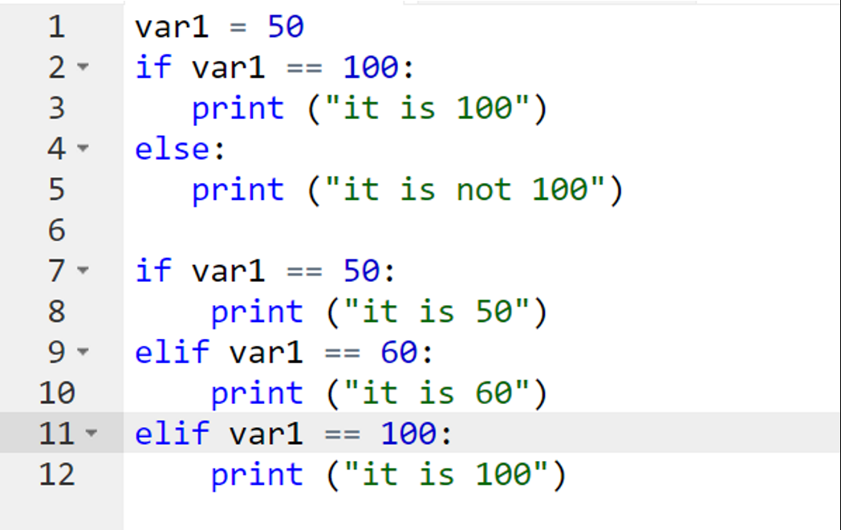
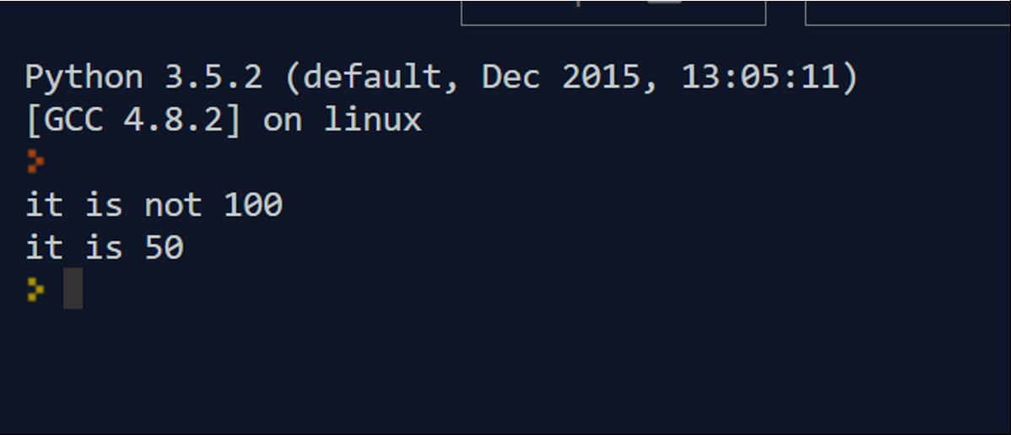
Conditional Statements – If, elif, else
The if statement contains a logical expression using which data is compared and a decision is made based on the result of the comparison.
An else statement can be combined with an if statement. An else statement contains the block of code that executes if the conditional expression in the if statement resolves to 0 or a FALSE value.
The elif statement allows you to check multiple expressions for TRUE and execute a block of code as soon as one of the conditions evaluates to TRUE.

Slide 26
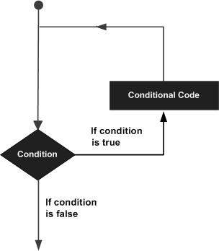
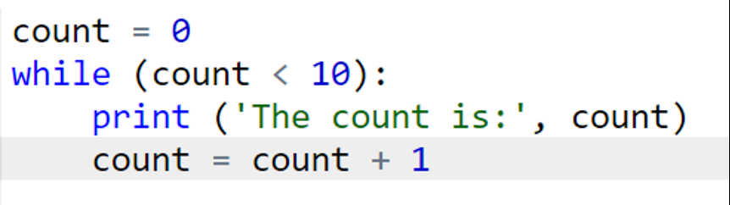
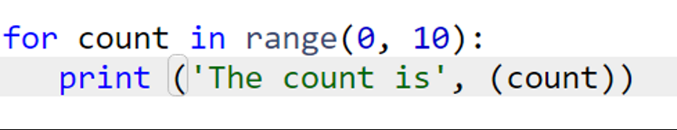
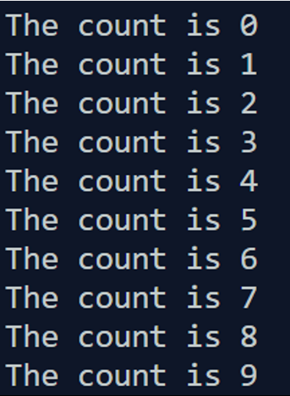
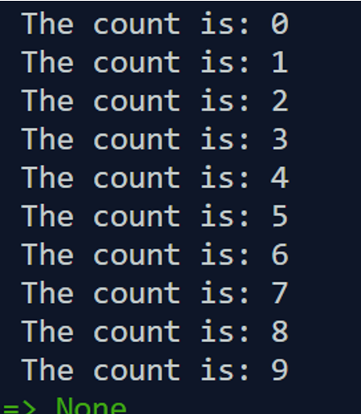
Loops – While, For
For Loop
While Loop

Slide 27
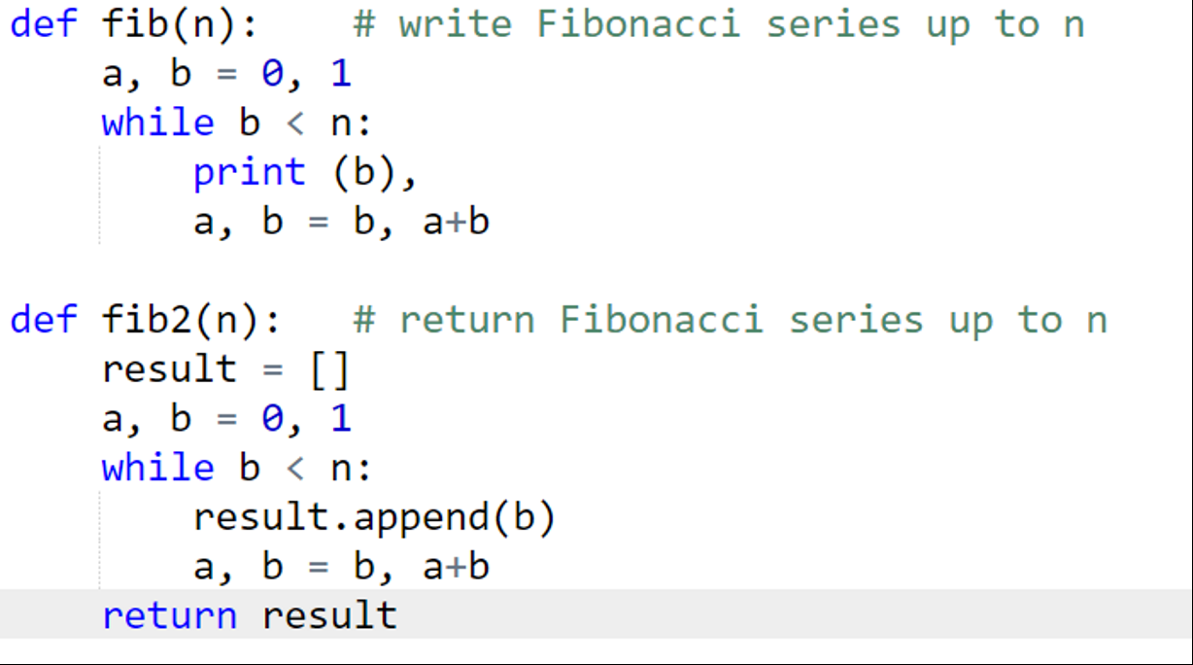
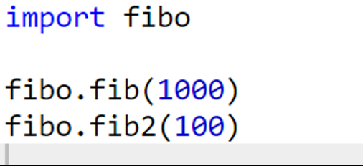
Using Modules
main.py
fibo.py

Slide 28
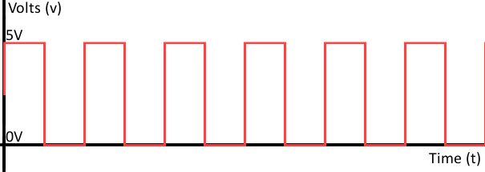
Digital Signals
A digital signal refers to an electrical signal that is converted into a pattern of bits. Unlike an analog signal, which is a continuous signal that contains time-varying quantities, a digital signal has a discrete value at each sampling point.
Digital signals must have a finite set of possible values. Most commonly digital signals will be one of two values – like either 0V or 5V. Timing graphs of these signals look like square waves.

Slide 29
Digital Input
GPIO outputs are easy; they are on or off, HIGH or LOW, 3v3 or 0v. Inputs are a bit trickier because of the way that digital devices work. Although it might seem reasonable just to connect a button across an input pin and a ground pin, the Pi can get confused as to whether the button is on or off. It might work properly, it might not. It's a bit like floating about in deep space; without a reference it would be hard to tell if you were going up or down, or even what up or down meant!
When a GPIO pin is in input mode and not connected to 3.3 volts or ground, the pin is said to be floating, meaning that it has no fixed voltage level.

Slide 30
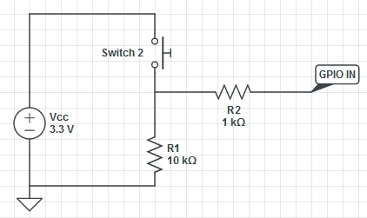
Pull Down
A pull down circuit:
Wire the GPIO pin to ground through a large (10kΩ) resistor so that it always reads LOW. Then you can short the pin to 3.3 volts by closing the circuit so that it goes HIGH. When the circuit is closed, there is a lower resistance path to 3.3 volts, and therefore the pin will read HIGH.

Slide 31
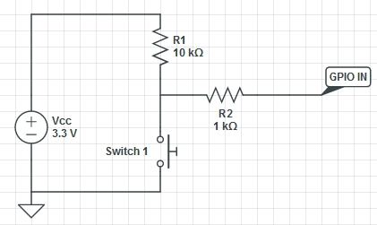
Pull Up
A pull up circuit
Wire the GPIO pin to 3.3 volts through a large (10kΩ) resistor so that it always reads HIGH. Then we can short the pin to ground by closing the circuit so that the pin will go LOW.

Slide 32
Digital Output
Using the GPIO outputs is an easy task. They are on or off. In other words, the signal on a GPIO output pin can be HIGH or LOW. HIGH means 3.3v and LOW means 0v.

Slide 33
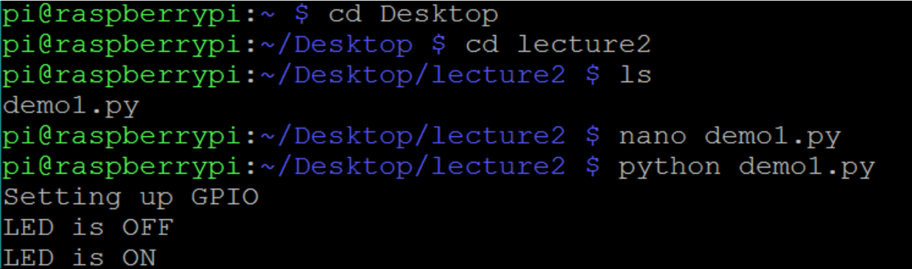
How to run python script?
- python demo1.py

Slide 34
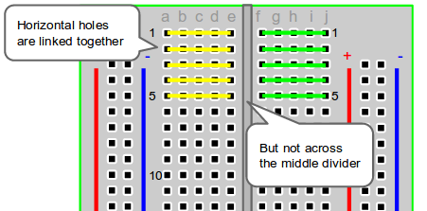
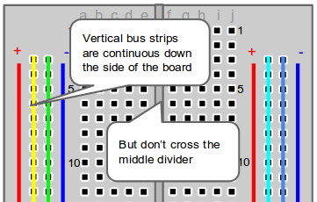
Breadboard

Slide 35
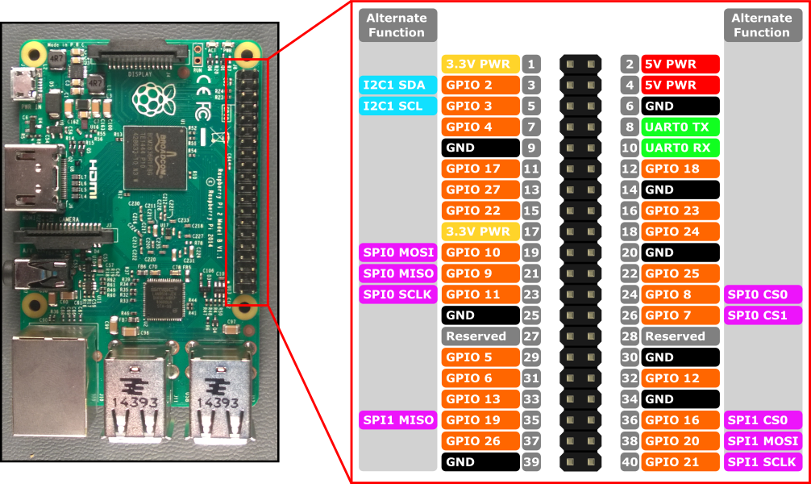
Pinout - Reminder

Slide 36
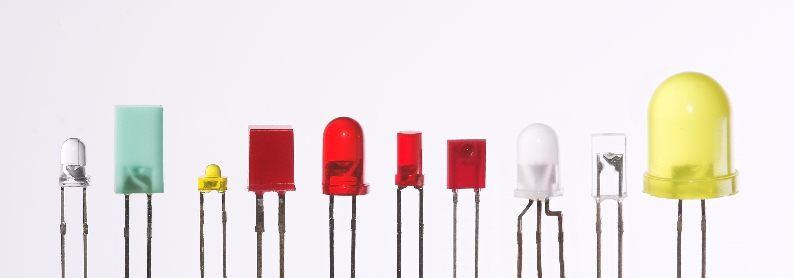
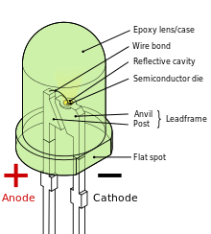
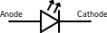
LED – Light-emitting diode
In the simplest terms, a light-emitting diode (LED) is a semiconductor device that emits light when an electric current is passed through it. Light is produced when the particles that carry the current (known as electrons and holes) combine together within the semiconductor material. (http://www.ledsmagazine.com/articles/2004/01/what-is-an-led.html)

Slide 37
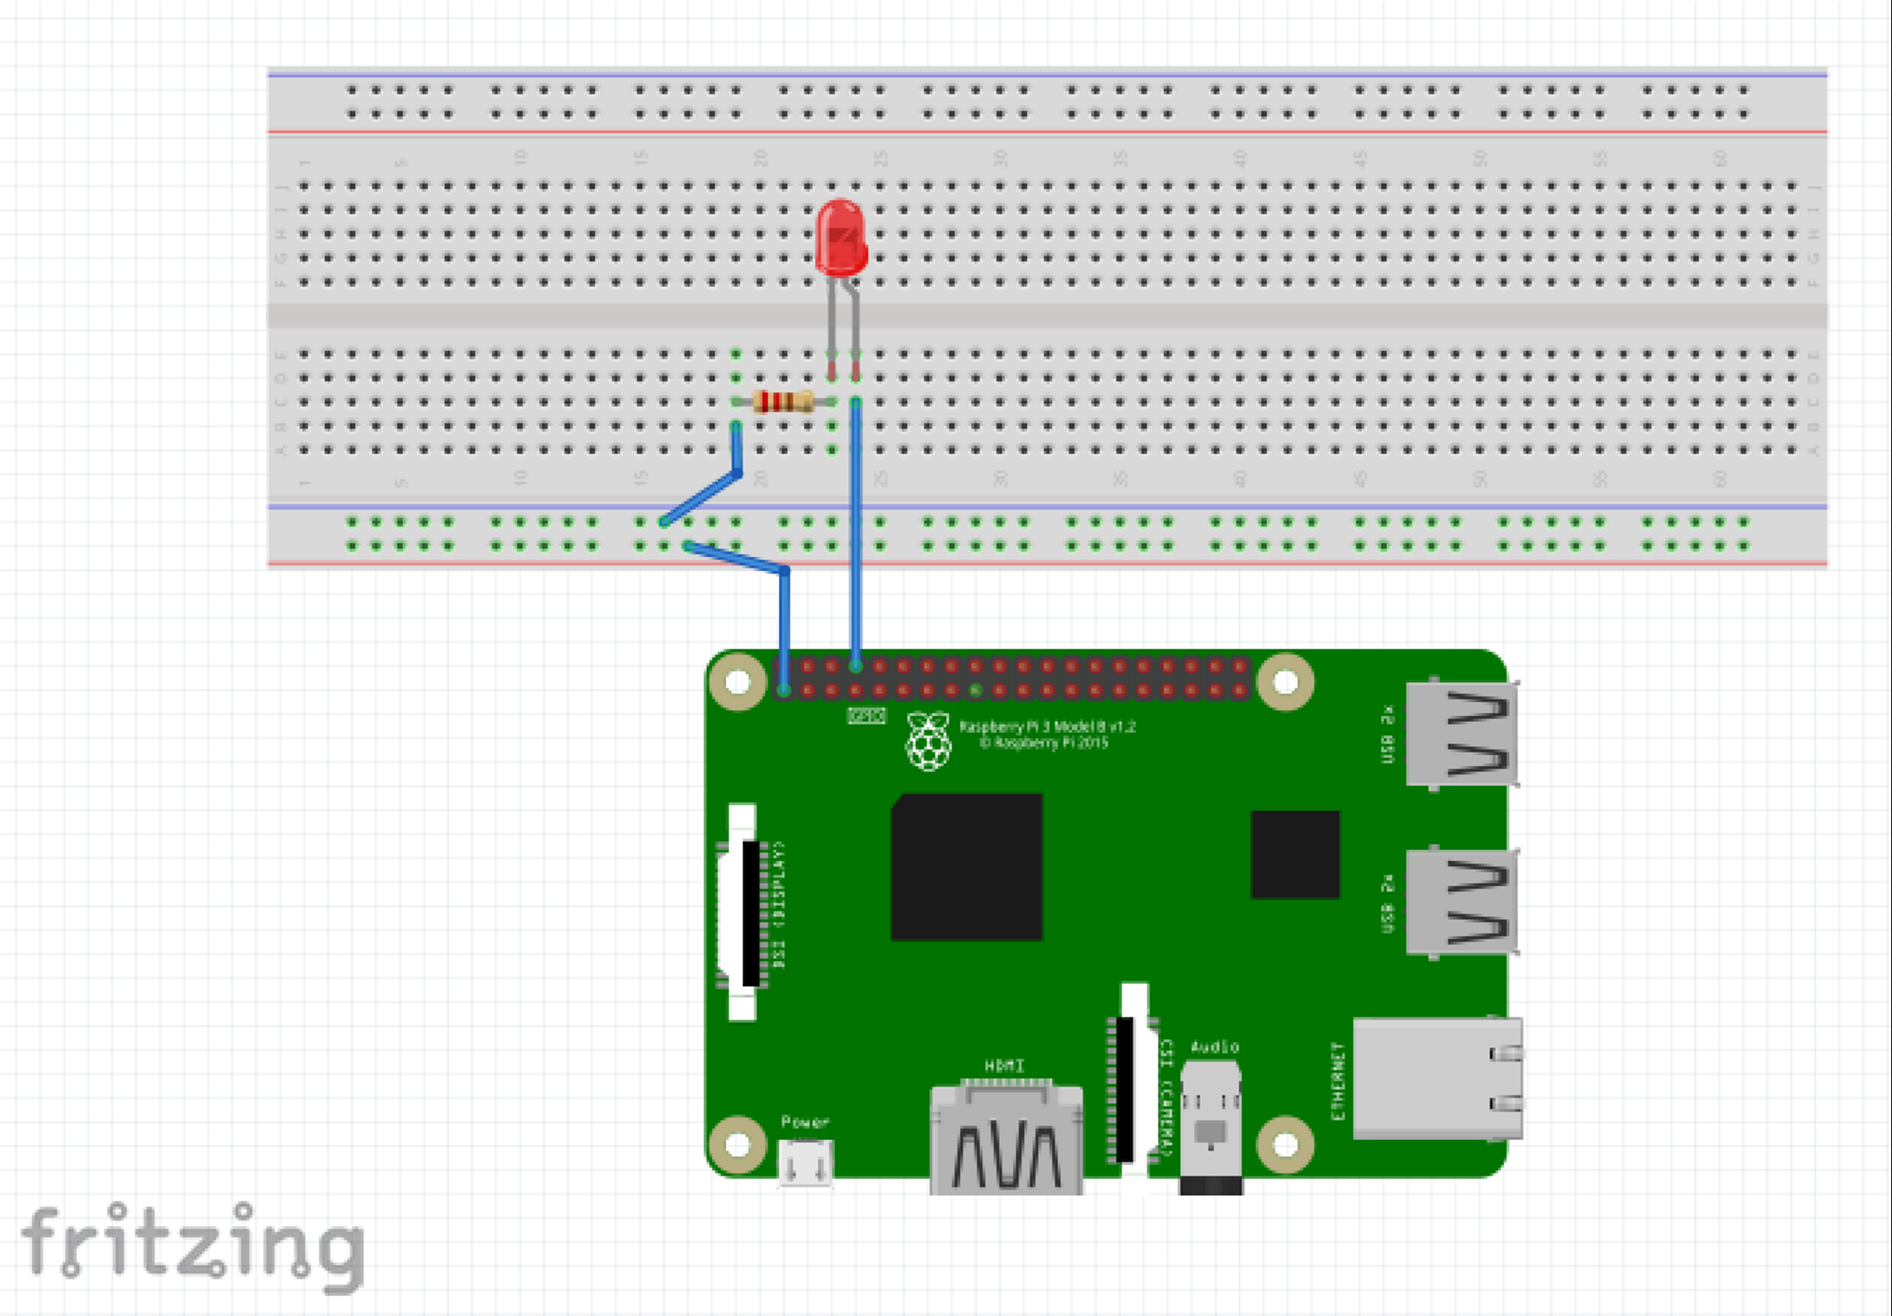
Blink a LED - Circuit Design – Demo 1

Slide 38
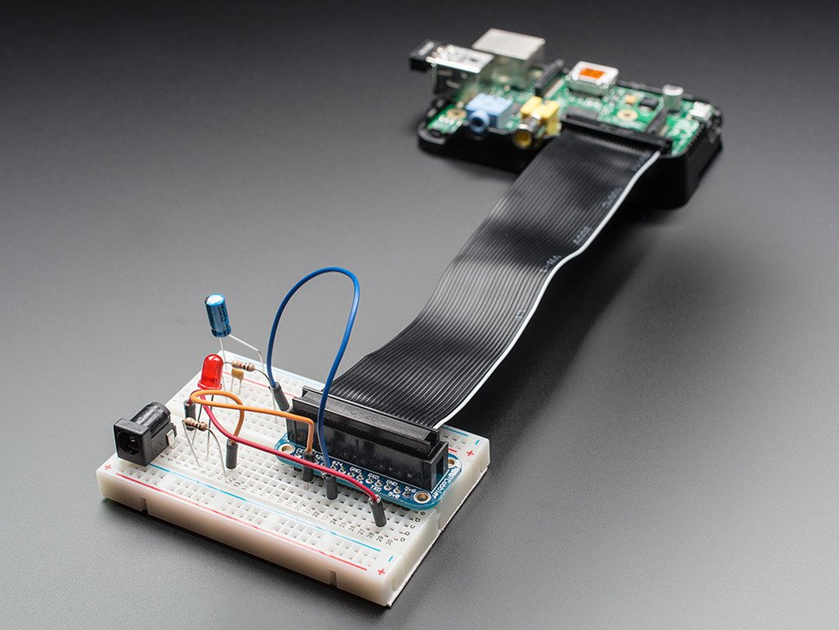
Assembled Pi Cobbler Breakout + Cable

Slide 39
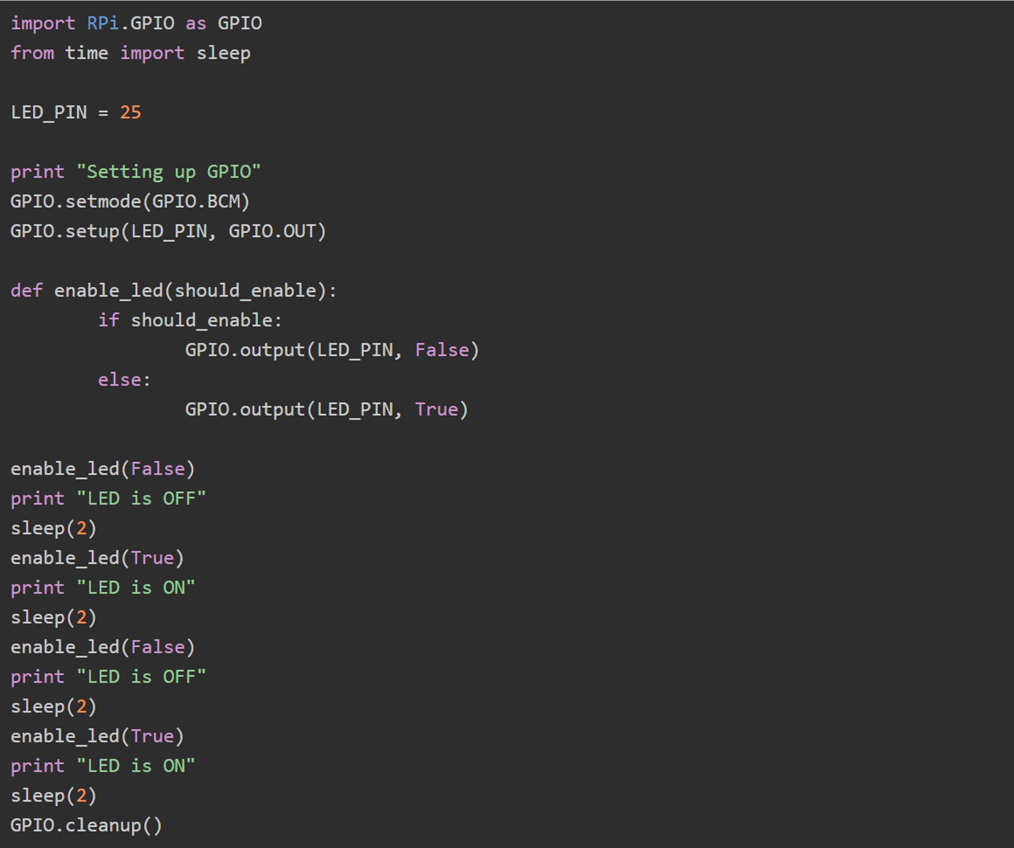
Code
https://learn.adafruit.com/debugging-with-the-raspberry-pi-webide/debug-a-blinking-led

Slide 40
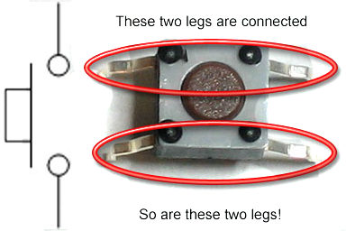
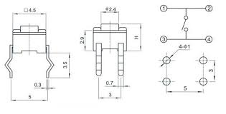
Push Button Switch
A push button is a momentary or non-latching switch which causes a temporary change in the state of an electrical circuit only while the switch is physically actuated. An automatic mechanism (i.e. a spring) returns the switch to its default position immediately afterwards, restoring the initial circuit condition.

Slide 41
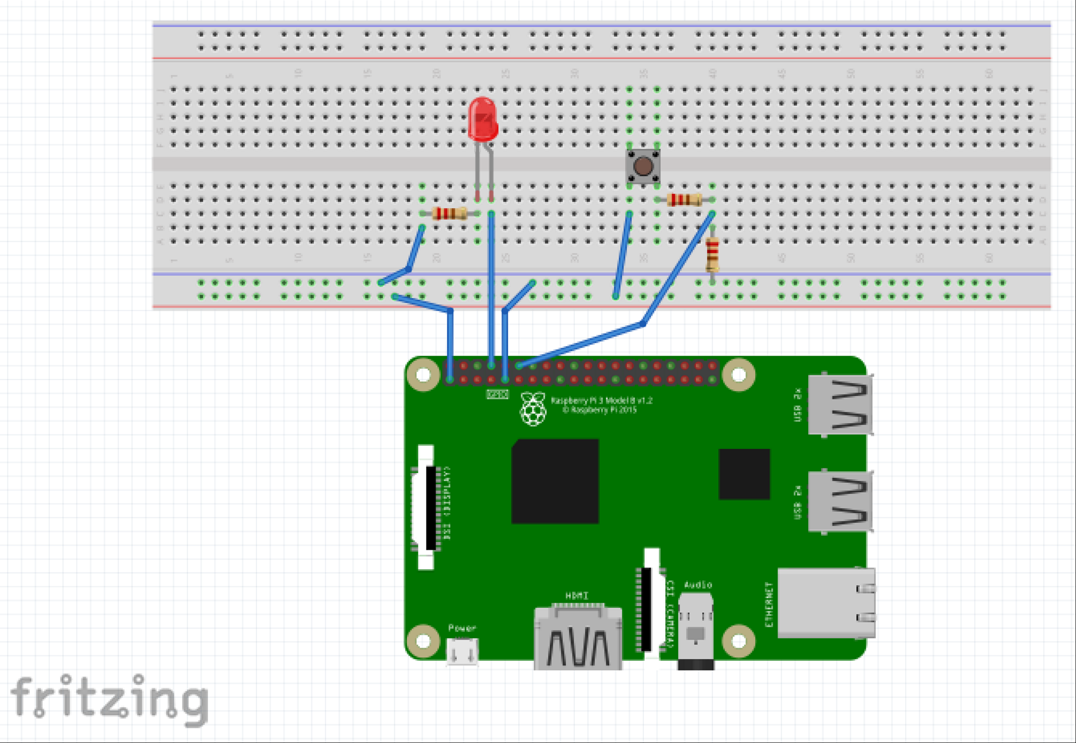
Circuit Design – Demo 2

Slide 42
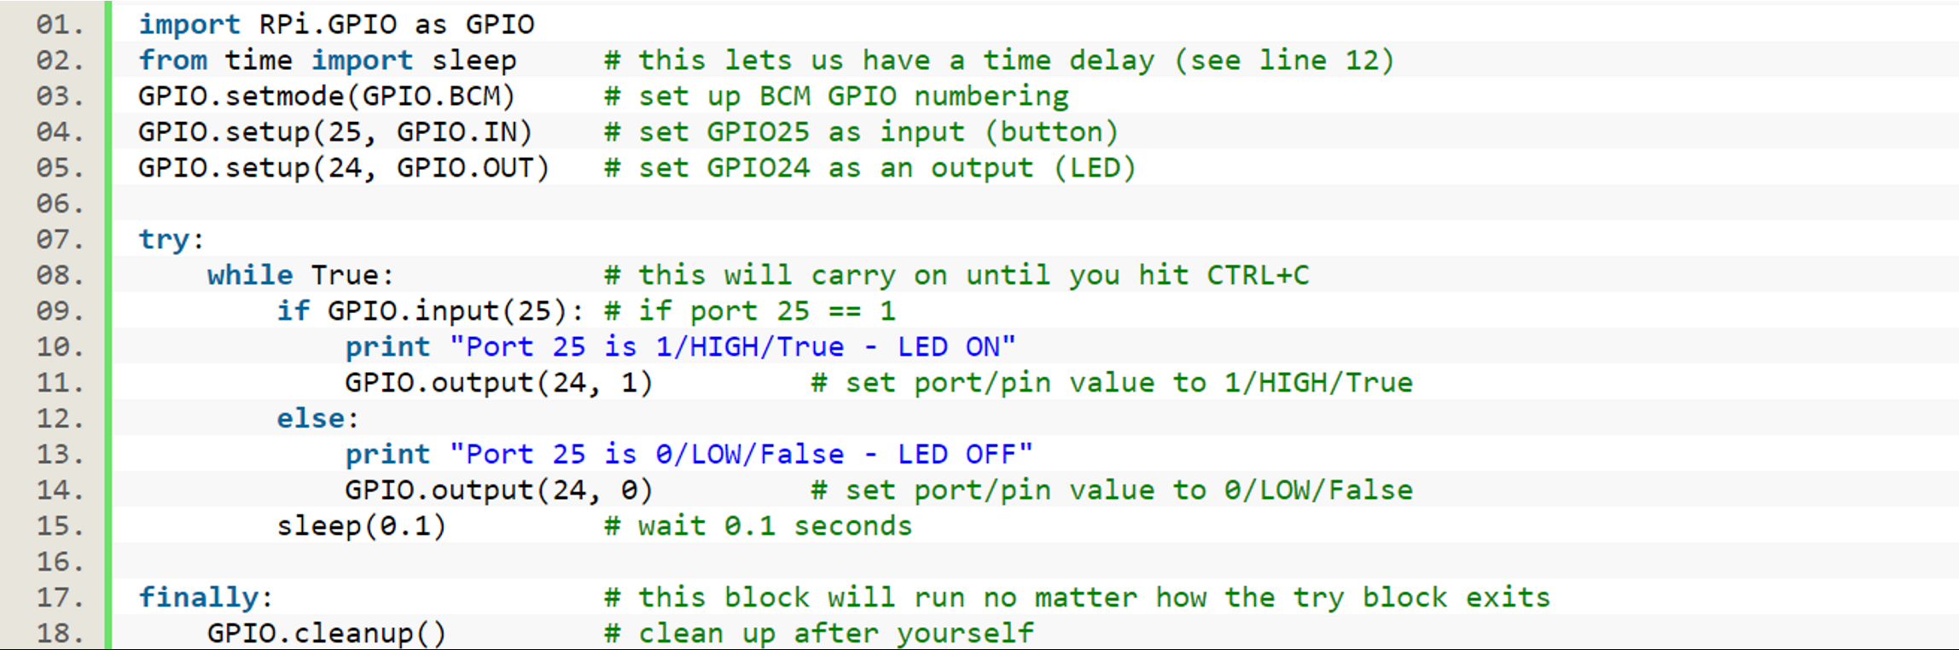
Code

Slide 43
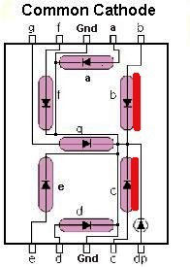
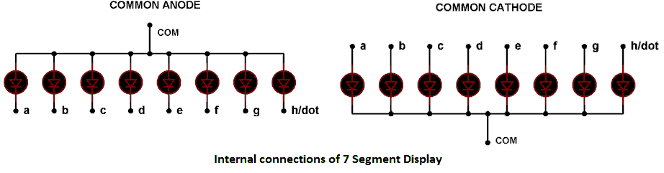
Seven Segment Display
The 7-segment display, also written as “seven segment display”, consists of seven LEDs (hence its name) arranged in a rectangular package.
Common Anode (CA): All the Negative terminals (cathode) of all the 8 LEDs are connected together (see diagram below), named as COM. And all the positive terminals are left alone.
Common Cathode (CC): In this all the positive terminals (Anodes) of all the 8 LEDs are connected together, named as COM. And all the negative thermals are left alone.
http://circuitdigest.com/microcontroller-projects/raspberry-pi-7-segment-display-tutorial
http://www.electronics-tutorials.ws/blog/7-segment-display-tutorial.html

Slide 44
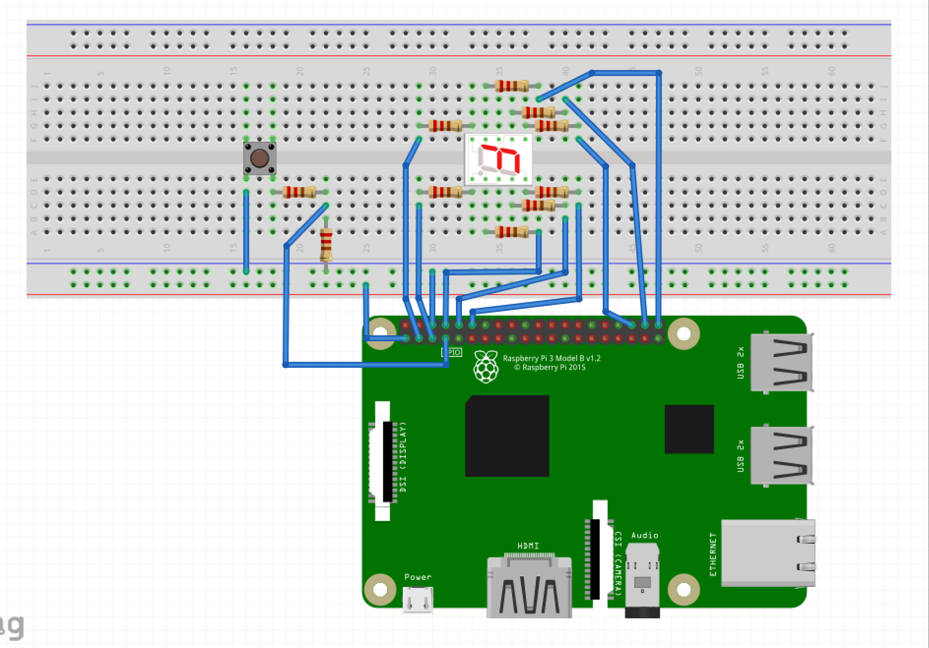
Circuit Design – Demo 3

Slide 45
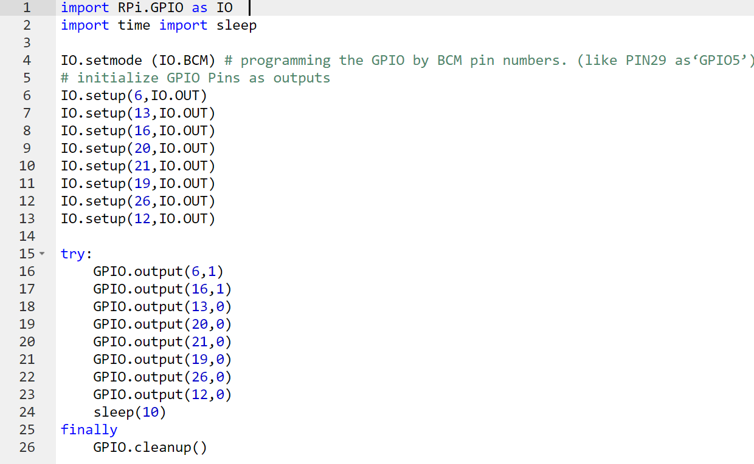
Code 1

Slide 46
Code 2
Create a dictionary for the digits
Read Button
If button is pressed increase the number on the display
When the display reaches 9, it should go back to 0
Wire all the cables
Define all the inputs and outputs

